Slide 1


LiteLOC v3 LOS to Sensor Calibration Color Sensor Board to Screen Calibration
Notes:
NOTE to instructors: Ensure you are in PRESENTATION MODE. Otherwise the built-in links will not function.

Slide 2
Objectives
By the end of this module, you will be able to:
Understand LiteLOC v3
Articulate the different steps of “LOS to Sensor Calibration”.
Articulate the different steps of “Sensor to Screen Calibration”.
Understand how the LiteLOC Brightness Bar works.
Explain why LiteLOC v3 is so important and a necessity.
Understand how temperature affects brightness
Understand how humidity affects brightness for projectors that use chillers.
Have knowledge on the Thermal Governor and Ambient Thermal Governor
Troubleshoot a “LiteLOC not achievable” Error

Slide 3
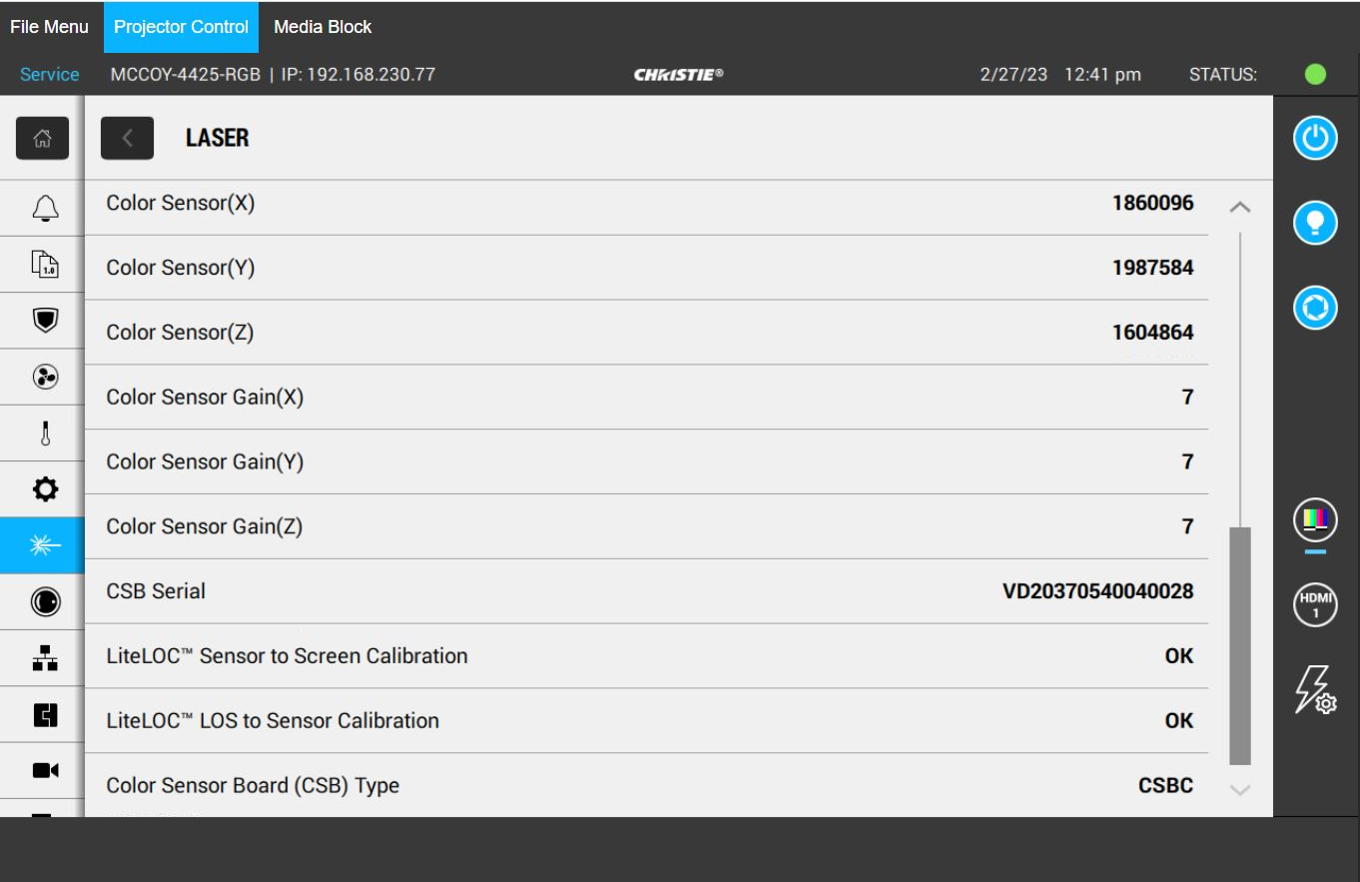
What is LiteLOC v3?
LiteLOC v3 Consists of Two Different Steps:
LOS to Sensor Calibration (Automatic Process): The lasers in our LOS are driven to determine the Color sensor values (X/Y/Z).
Sensor to Screen Calibration (Manual Process or Hawkeye Software): Calibrate the on-screen color and brightness to the color sensor values (CX, CY and CZ). This is performed at multiple brightness levels. Note: In advance of performing “LOS to Sensor Calibration”, “Sensor to Screen Calibration” must be complete.
Notes:
Note: The LOS to Sensor Calibration is always different when looking at one projector compared to another.
Note: The Sensor to Screen Calibration is always different when looking at one projector compared to another.
If we have an issue with either type of Calibration, it will be reported on the UI under “Status” -> “Laser”
CX = Csense X
CY = Csense Y
CZ = Csense Z

Slide 4
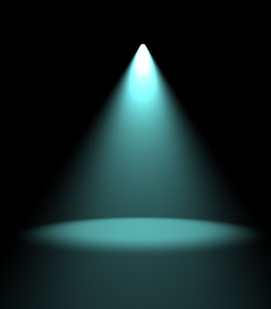
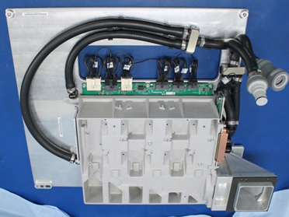
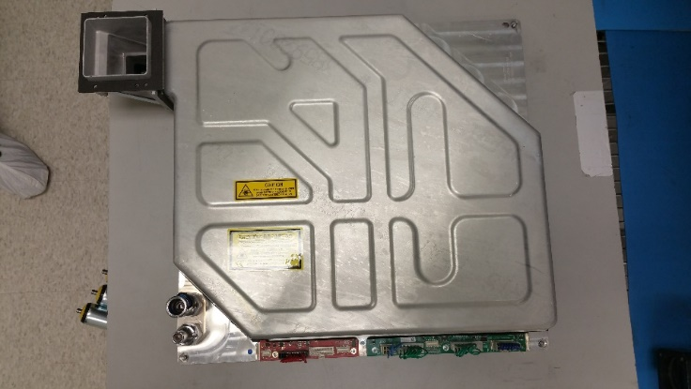
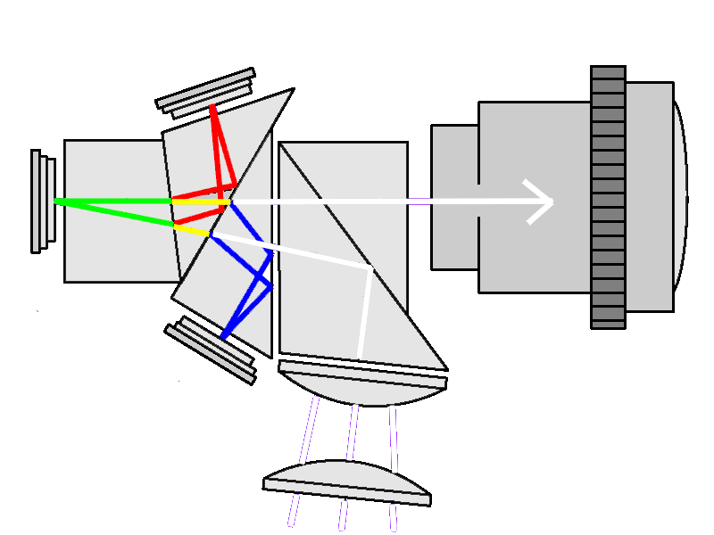
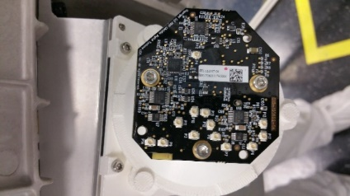

What is LiteLOC V3
Screen
LOS to Sensor Calibration
Characterizes the LOS output and the CX, CY and CZ reading:
All series 4 models (SW Ver 1.5 and above)
Fully automated processes.
LOS Serial number is recorded on the CSB to link the calibration data to the LOS
The calibration process is triggered automatically if the system finds the calibration parameters are not stored on the CSBD (new board) or if the system detected a new LOS has been installed
Sensor to Screen Calibration
Characterizes the CX, CY and CZ and the perceived color and brightness measured on the screen. This calibration allows the operator to type the desired white point on the projector UI then the system automatically sets the R, G and B laser drive current to achieve the settings. This calibration is available for Series 4 only.
Calibration is done at the factory. It can be recalibrated on-site to maximize the system efficiency especially when the system will be used for 3D.
Calibration must be redone if the LOS, the CSBD or the Light Engine have been replaced
Notes:
NOTES:
CSB = Color Sensor Board
LOS = Laser Optical Subsystem
Note: We perform a factory “Sensor to Screen Calibration” for every projector. Although it’s done at the factory, it can be redone at a new installation (good practice).

Slide 5
LiteLOC v3 – LOS to Sensor Calibration
How does LOS to Sensor Calibration Work?
This calibration is performed in the factory for every brand-new projector.
If we replace a CSB (Color Sensor Board) or LOS (Laser Optical Subsystem) in a Series IV Cinema projector, our CAVE board will detect that one has been replaced. Next, LOS to Sensor calibration will automatically begin calibrating itself at first light on instance to ensure the Color Sensor Board values (X/Y/Z) are associated to the optimal LOS drive levels.
The CAVE board knows when a LOS or CSB has been replaced since the CAVE logs the LOS serial number and the CSB serial number. Once it detects a different SN, it initiates the Sensor (CSB) to LOS calibration process.
This is a fully automatic process, so no work is required from the user.

Slide 6
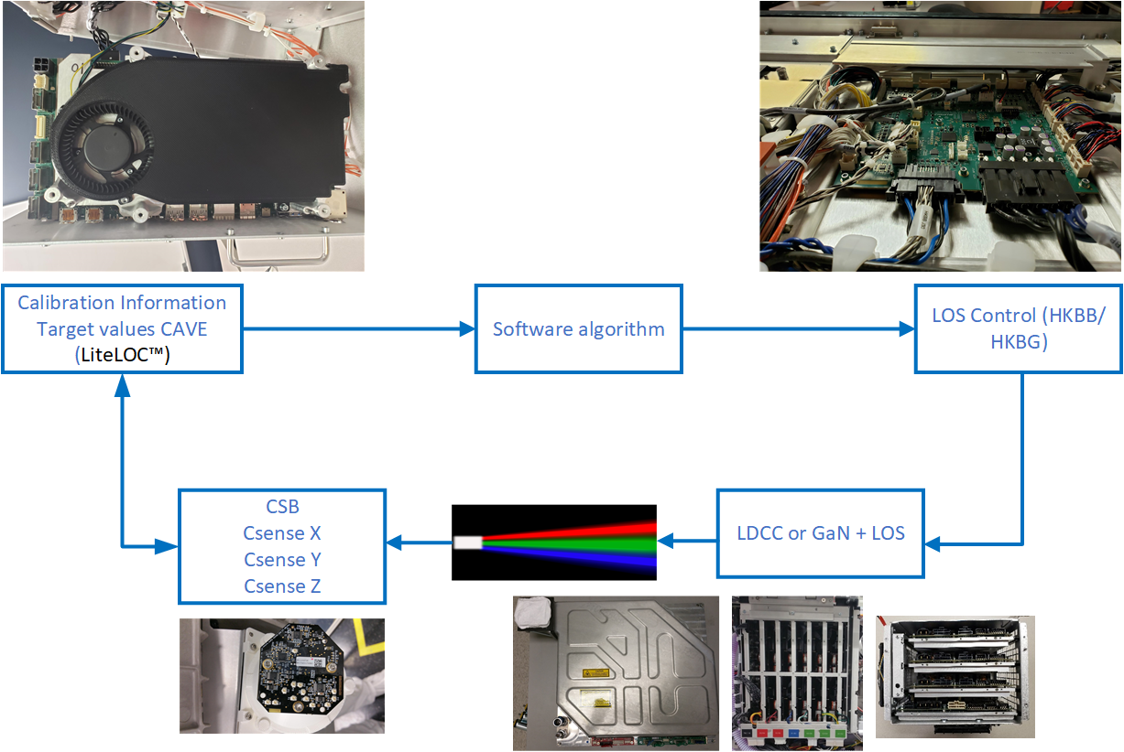
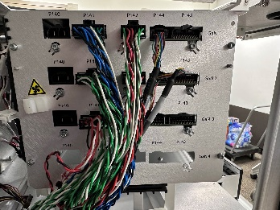
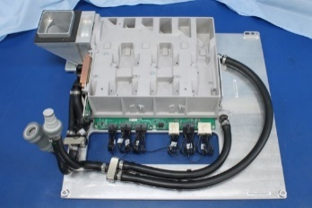
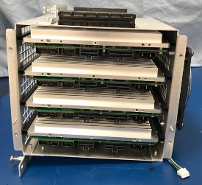
LiteLOC v3 – LOS to Sensor Calibration
Notes:
Here we can see the LOS to Sensor Calibration process.

Slide 7
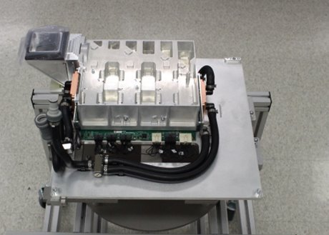
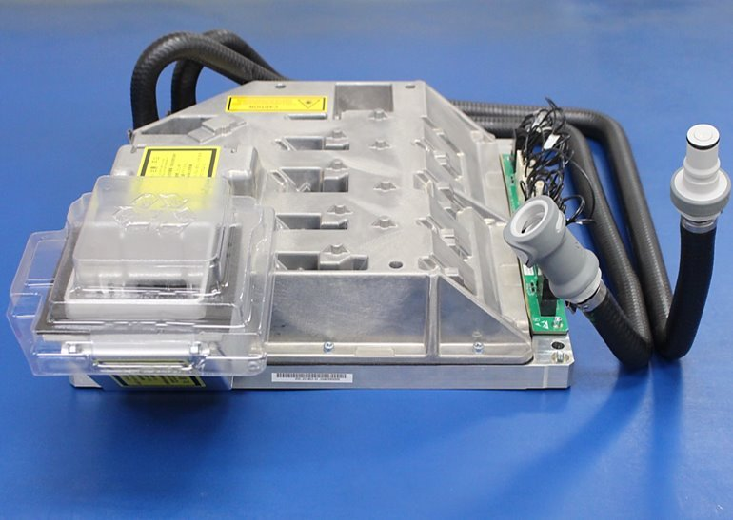
LiteLOC v3 – LOS to Sensor Calibration
The LOS and IOS:
If replacing an LOS or IOS, immediately after the first powerup an automatic "LOS-to-Sensor Calibration will take place.
The problem with this is that the calibration is not optimal since a Coupling Mirror Adjustment needs to be done.
For this reason, it's recommended to send the following commands to a projector via port 5103 after the coupling mirror adjustment (when swapping an LOS or IOS):
(RGB+INVL 2)
(RGB+INVL 2 “FACTORY”)
(RGB+CAL3)
Notes:
Note: After performing a “Sensor to Screen Calibration” is complete we should be doing a “LOS to Sensor Calibration”.
; INVL 1 – Invalidate the Sensor to Screen Calibration. First command deletes field calibration, second one deletes the factory location.
; INVL 2 – Invalidates the LOS to Sensor Calibration. Then we set the factory calibration data to the projector. First command deletes field calibration, second one deletes the factory location.
----------------------------------------------------------------------------------------------------------------
Therefore: If replacing an IOS, we need to send those 4 commands:
; For Cinema Applications, we don’t need to turn on the LOS at all. We can simply send the 4 commands during standby.
; For Enterprise Applications, we need to turn on the LOS (laser light) and then send these commands.
After successfully sending the 4 commands, we must next perform “Sensor to Screen Calibration”.
After “Sensor to Screen Calibration” is successfully complete, the projector will automatically perform “LOS to Sensor Calibration”.

Slide 8
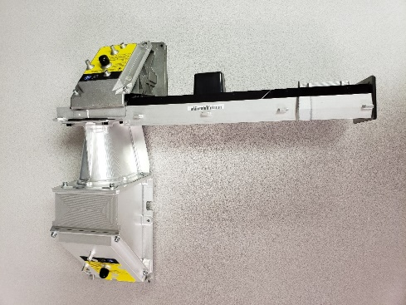
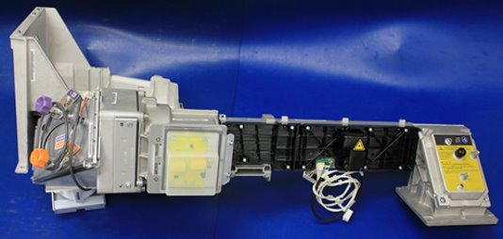
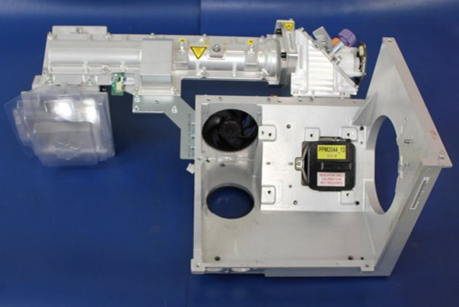
LiteLOC v3 – LOS to Sensor Calibration
The IOS:
This IOS sits between the LOS and CSB. Due to this, it can affect the CX, CY and CZ and LOS drive levels.
If replacing the IOS we must delete the existing calibration by sending the following command to port 5103 then power cycle the projector to trigger the automated software process:
(RGB+INVL 2)
(RGB+INVL 2 “FACTORY”)
(RGB+CAL3)
We must do this manually since the IOS optical components don't have a SN to report to the CAVE. When the LOS or CSBD are changed, the CAVE see's a different serial number and triggers the automatic LOS-to-Sensor Calibration.
CP4445/55-RGB
IOS
CP4425/35-RGB
IOS
CP2415/20-RGB
IOS
Notes:
Note: After performing a “Sensor to Screen Calibration” is complete we should be doing a “LOS to Sensor Calibration”.
; INVL 1 – Invalidate the Sensor to Screen Calibration. First command deletes field calibration, second one deletes the factory location.
; INVL 2 – Invalidates the LOS to Sensor Calibration. Then we set the factory calibration data to the projector. First command deletes field calibration, second one deletes the factory location.
----------------------------------------------------------------------------------------------------------------
Therefore: If replacing an IOS, we need to send those 4 commands:
; For Cinema Applications, we don’t need to turn on the LOS at all. We can simply send the 4 commands during standby.
; For Enterprise Applications, we need to turn on the LOS (laser light) and then send these commands.
After successfully sending the 4 commands, we must next perform “Sensor to Screen Calibration”.
After “Sensor to Screen Calibration” is successfully complete, the projector will automatically perform “LOS to Sensor Calibration”.

Slide 9
LiteLOC v3 – LOS to Sensor Calibration
Commands to Remember:
(RGB+INVL 1) ; Invalidates Sensor to Screen Calibration
(RGB+INVL 1 “FACTORY”) ; Invalidates Sensor to Screen Calibration Factory Location
(RGB+INVL 2) ; Invalidates LOS to Sensor Calibration
(RGB+INVL 2 “FACTORY”) ; Invalidates LOS to Sensor Calibration Factory Location
(RGB+CAL3) ; Forces a new LOS to Sensor Calibration.
Notes:
Note: After performing a “Sensor to Screen Calibration” is complete we should be doing a “LOS to Sensor Calibration”.
; INVL 1 – Invalidate the Sensor to Screen Calibration. First command deletes field calibration, second one deletes the factory location.
; INVL 2 – Invalidates the LOS to Sensor Calibration. Then we set the factory calibration data to the projector. First command deletes field calibration, second one deletes the factory location.
----------------------------------------------------------------------------------------------------------------
Therefore: If replacing an IOS, we need to send those 4 commands:
; For Cinema Applications, we don’t need to turn on the LOS at all. We can simply send the 4 commands during standby.
; For Enterprise Applications, we need to turn on the LOS (laser light) and then send these commands.
After successfully sending the 4 commands, we must next perform “Sensor to Screen Calibration”.
After “Sensor to Screen Calibration” is successfully complete, the projector will automatically perform “LOS to Sensor Calibration”.

Slide 10
LiteLOC v3 – Sensor to Screen Calibration
Sensor to Screen Calibration
There are three different methods of performing Sensor to Screen Calibration:
Follow the Instructions in document 020-103436-XX.
Follow the instructions in the Remote UI (Color Settings -> Sensor-to-Screen Calibration).
Use Hawkeye Software.
Hawkeye Software is recommended since:
It’s a fully automated process.
Fastest method.
Eliminates human error.
There is a separate PowerPoint that explains how to setup Hawkeye software in order to perform the Sensor to Screen Calibration.

Slide 11
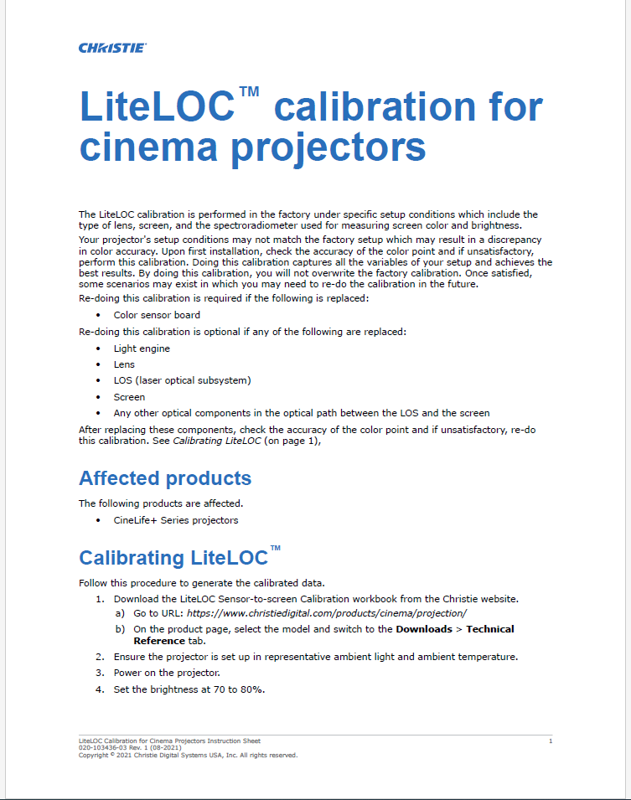
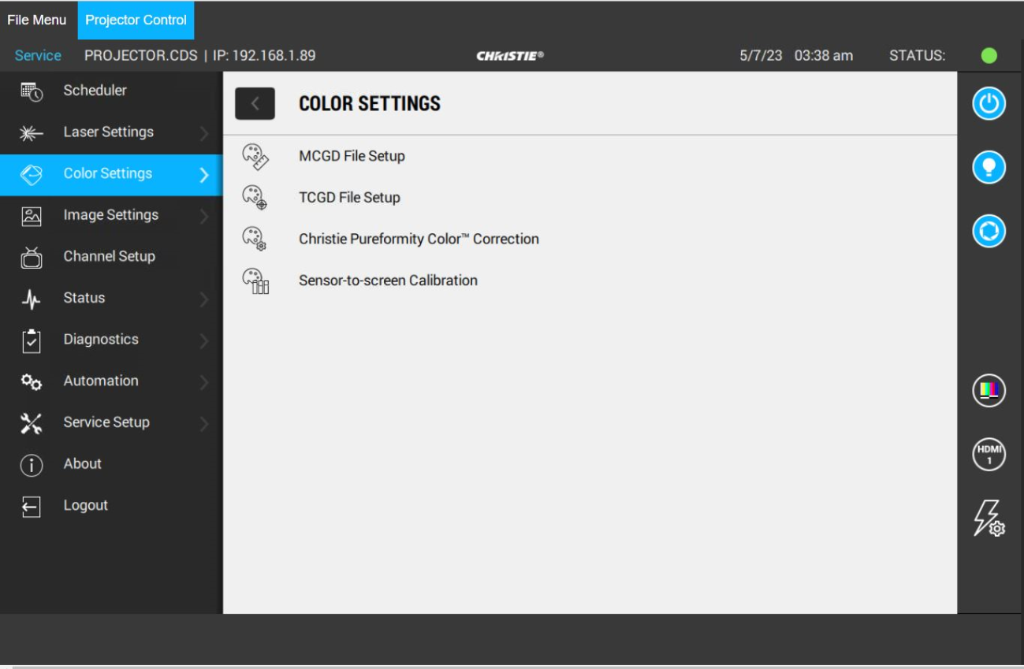
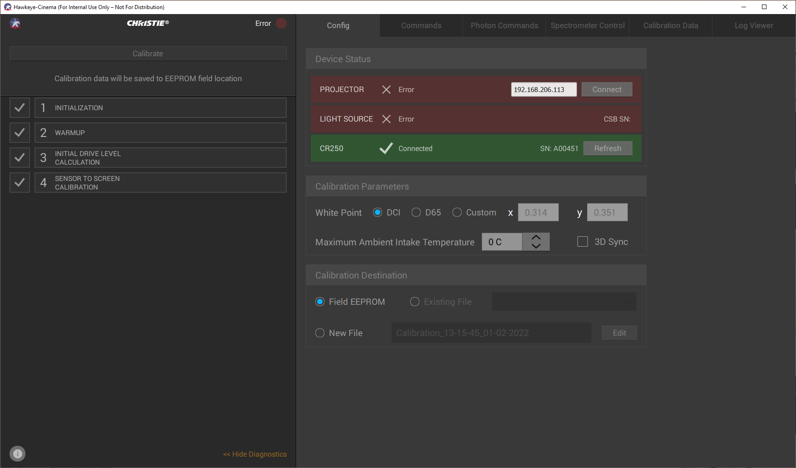
LiteLOC v3 – Sensor to Screen Calibration
Sensor to Screen Calibration
Below are images of these three different methods:
Document
User Interface
Hawkeye

Slide 12
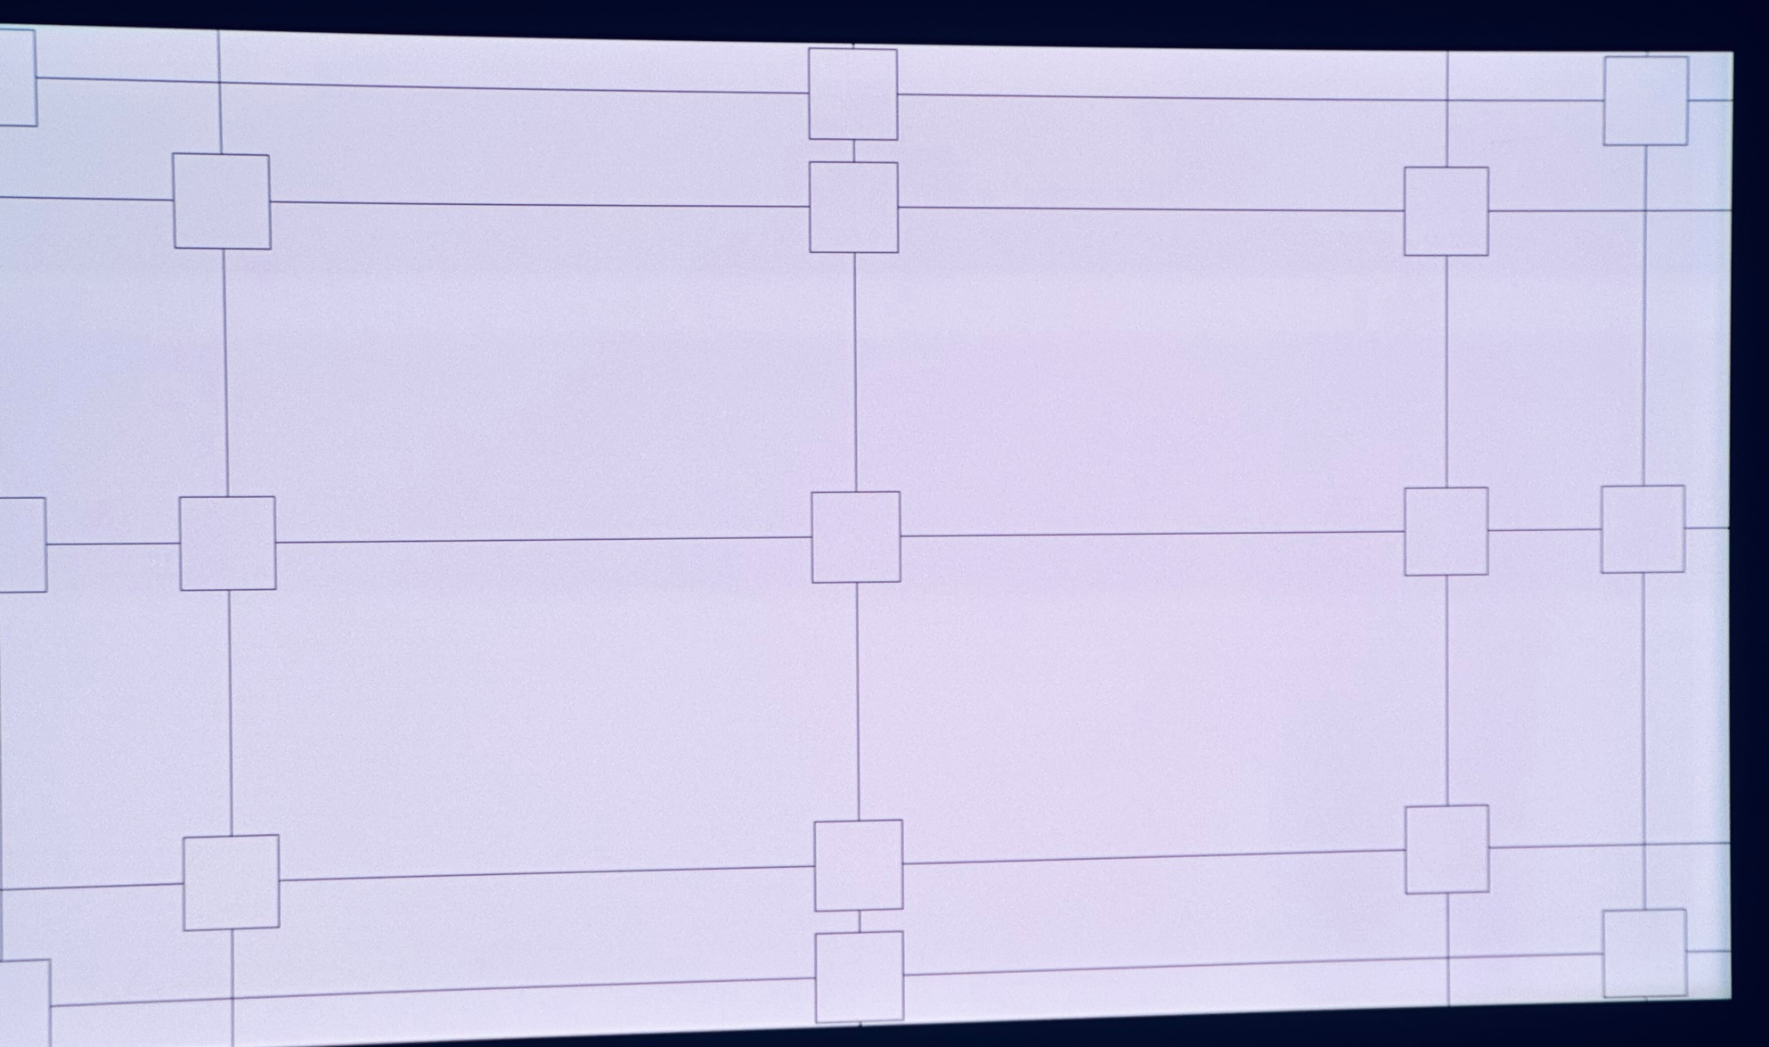
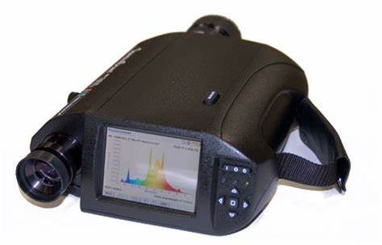
LiteLOC v3 – Sensor to Screen Calibration
What is happening during the Sensor-to-Screen Calibration:
We must first determine which chromaticity values we would look to stay consistent for our projector output. DCI standards are the following:
X = 0.314 (+/- 0.002)
Y = 0.351 (+/- 0.002)
Next, we use a Spectroradiometer (ex: PR655) and shoot the luminance at different brightnesses.

Slide 13
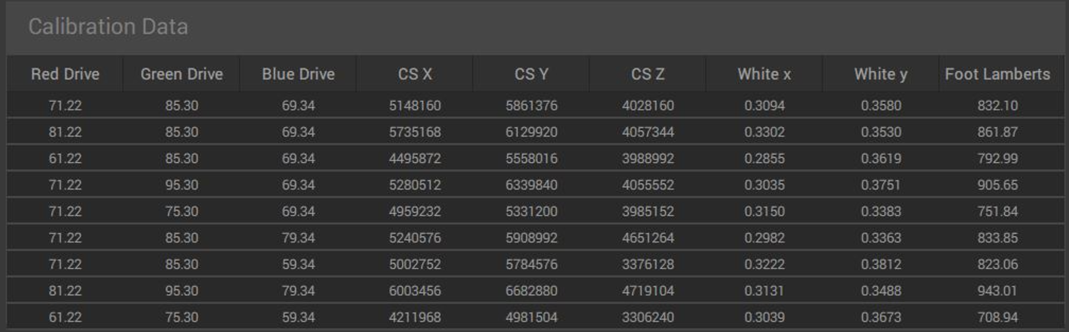
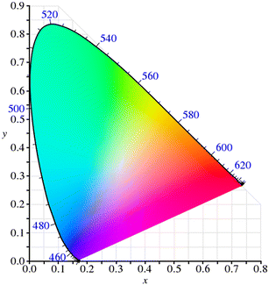
LiteLOC v3 – Sensor to Screen Calibration
What is happening during the Sensor-to-Screen Calibration (Continued):
The calibration process will increase and decrease our drive colors (Red, Green and Blue) by 20%. When this happens, our tristimulus for CSENSE is recorded (CS X. CS Y and CSZ) and the tristimulus for our spectroradiometer are recorded (White x, White y and Foot Lambert).
A total of 9 measurements are taken.
After recording all of these values, we can determine the math model used to achieve certain brightnesses and colors.
Notes:
Note: Line 8 of our Sensor-to-Screen Calibration has our maximum DCI laser drive levels for cinema.
Note: Line 8 of our Sensor-to-Screen Calibration has our maximum native laser drive levels for Enterprise.

Slide 14
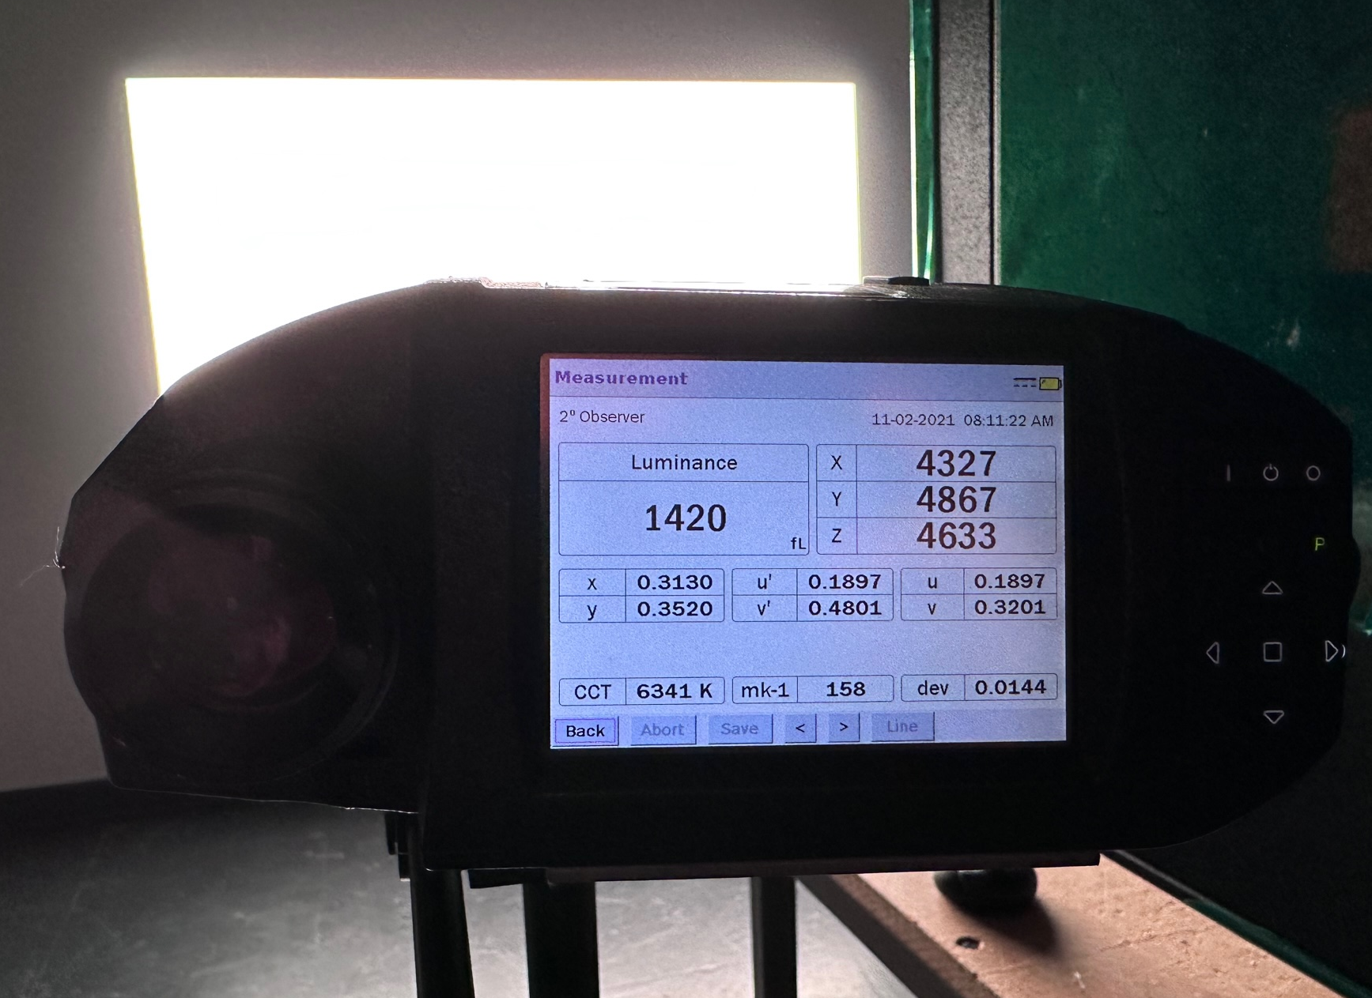
LiteLOC v3 – Sensor to Screen Calibration
What is happening during the Sensor-to-Screen Calibration (Continued):
After we shoot the correct color chromaticity co-ordinates (x, and y) per each laser drive level, our CSB records the values associated to CX, CY and CZ.
A math model is used to drive the projector to a certain brightness + color as per user input after calibration is complete.

Slide 15
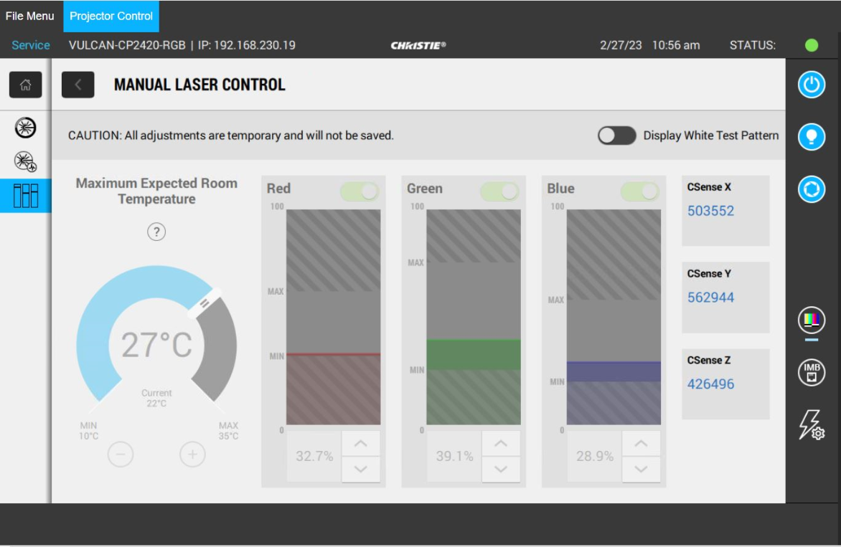
LiteLOC v3 – Sensor to Screen Calibration
What is happening during the Sensor-to-Screen Calibration (Continued):
Here we can see the CX, CY and CZ values for reference along with some Laser Current and Voltage. Note that all these values are saved in the background. The purpose of sharing this pictures is only for reference.

Slide 16
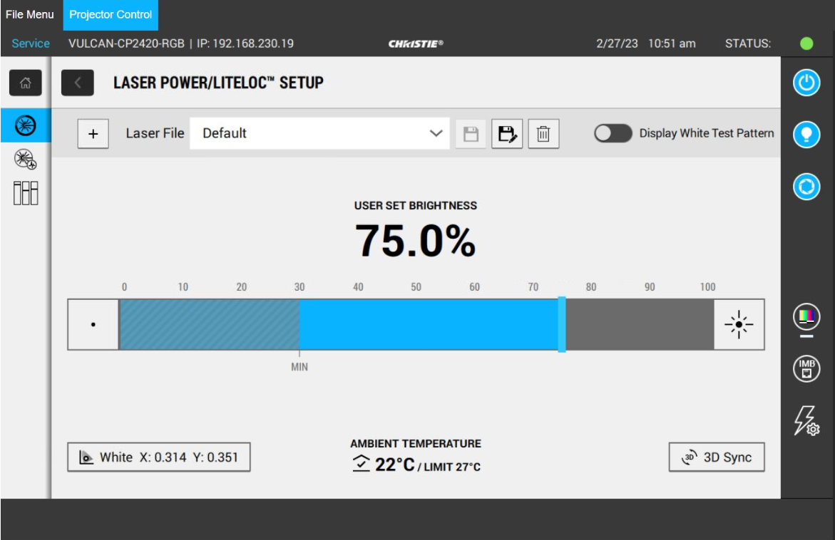
LiteLOC v3 – Sensor to Screen Calibration
What is the result after a Successful Screen Calibration?
On the Main Menu under “Laser Settings”, you can next click on “LASER POWER/LITELOC SETUP”. Here you will have a nice slider bar that allows you to bring up or down the brightness. When moving brightness up or down on this screen you’ll be able to always maintain the same color chromaticity values!

Slide 17
LiteLOC v3 – Sensor to Screen Calibration
What if I need different Target White points?
You can select the bottom left part of the LASER POWER/LITELOC Setup screen that identifies your White target color. When doing this, you have the option to change your white target. Changing the white target is possible, but your onscreen brightness will not be maximum.
For maintaining maximum brightness for a different color target, it is preferred to setup a separate “Sensor to Screen File”.
Notes:
Laser files are created to achieve the target white point and the target brightness.
Multiple laser configuration files can be created to represent different:
Screen size (Flat/Scope).
Brightness requirement / Target white point (DCI / D65)
Type of content (2D/3D/Alternative content)
Etc.

Slide 18
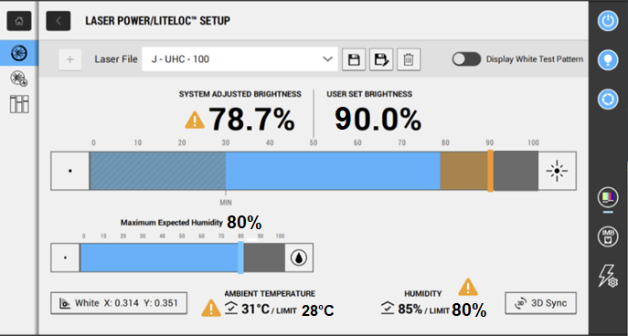
LiteLOC v3 – Remote UI Screen
LiteLOC Setup Screen:
You’ll notice that the CP4445-RGB and CP4455-RGB projectors will have an additional bar on the screen that identifies “Maximum Expected Humidity”. This is because these 2 models have an external chiller.
You’ll notice other Series IV OctoLas models (CP2415-RGB, CP2420-RGB, CP4415-RGB GEN2, CP4420-RGB GEN2, CP4425-RGB and CP4435-RGB do NOT have this “Maximum Expected Humidity” bar. This is because these models to NOT have an external chiller.

Slide 19
LiteLOC v3 – Remote UI Screen
LiteLOC Setup Screen:
Laser Projectors are affected by temperature. If we run lasers at higher temperatures without reducing brightness we would reduce laser life below 30K hours.
To maintain a 30k laser life, LiteLOC automatically reduces the brightness output as temperatures increase. The LiteLOC screen will identify the system adjusted brightness as temperatures increase (Identified on UI as “System Adjusted brightness”).
The LiteLOC screen will also identify the needed temperature to achieve the user set brightness (Identified on UI as “Ambient Temperature - Limit”).
Humidity is also shown on this screen. Max Humidity selected is used to find the Ambient Temperature – Limit for your selected brightness.

Slide 20
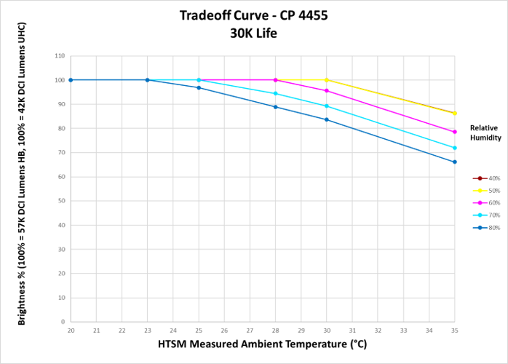
LiteLOC v3 –Thermal Governor
Thermal Governor:
Thermal Governor: Used in our and CP4445-RGB and CP4455-RGB projector.
When LiteLOC is enabled, the Thermal Governor is used to bring down output brightness at higher temperatures. This is important since it not only protects the lasers to ensure a long life, but it also protects much more. One of the additional components that it protects is the Light Engine from running over temperature.
Here we can see an example of how a Thermal Governor will bring down brightness at specific temperatures + humidity levels for a projector.
Brightness
Temperature
Notes:
HTSM = Humidity Temperature Sensor
The HTSM measures both humidity level and temperature.

Slide 21
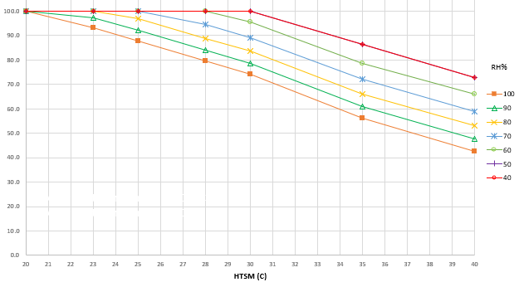
LiteLOC v3 –Thermal Governor – LiteLOC Display
Thermal Governor Implementation in the Remote UI – Ambient Temperature Limit
1
LL%
Example
Thermal Gov
2
3
Temperature
Notes:
Disregard the blue lines in this picture.
1 – Take the User Set Brightness, draw a vertical line on the Thermal Governor chart. We drew it at 90%
2 – Take the Humidity, draw a diagonal line on the Thermal Governor chart.
3 – Intersect the two lines and that will tell you the ambient temperature limit to achieve your brightness preference with LiteLOC.

Slide 22
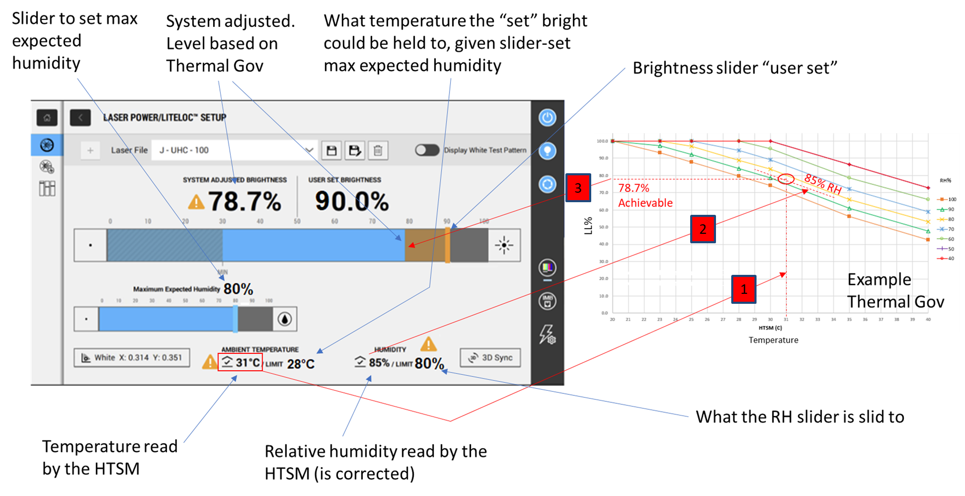
LiteLOC v3 –Thermal Governor – LiteLOC Display
Thermal Governor Implementation in the Remote UI – System Adjusted Brightness Condition
Notes:
HTSM = Humidity Temperature Sensor
1 – Take the Ambient Temperature, draw a vertical line on the Thermal Governor chart. We drew it at 31C
2 – Take the Humidity, draw a diagonal line on the Thermal Governor chart. In this case the line exists between two defined lines (80 % and 90%).
3 – Find point where two drawn lines intersect. Then, read the LiteLOC percentage at the point by drawing a horizontal line to the left (Brightness axis).

Slide 23

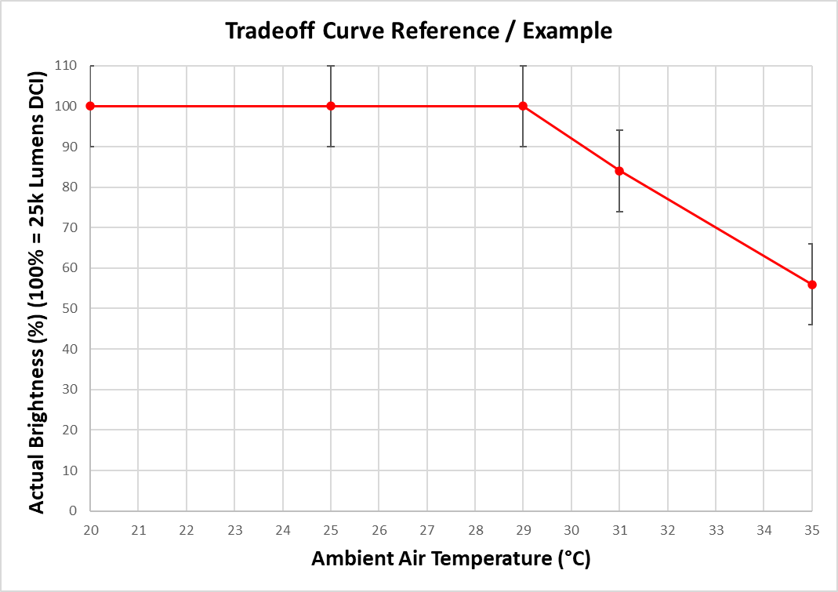
LiteLOC v3 – Ambient Thermal Governor
Ambient Thermal Governor:
Ambient Thermal Governor: Used in all OctoLas projectors that do NOT have a chiller. It is the same concept as the “Thermal Governor”, but the Ambient Thermal Governor is much simpler. This is because we do not capture humidity.
Below is a sample example showing the curve of a non-chiller OctoLas projector.
Notes:
HTSM = Humidity Temperature Sensor

Slide 24
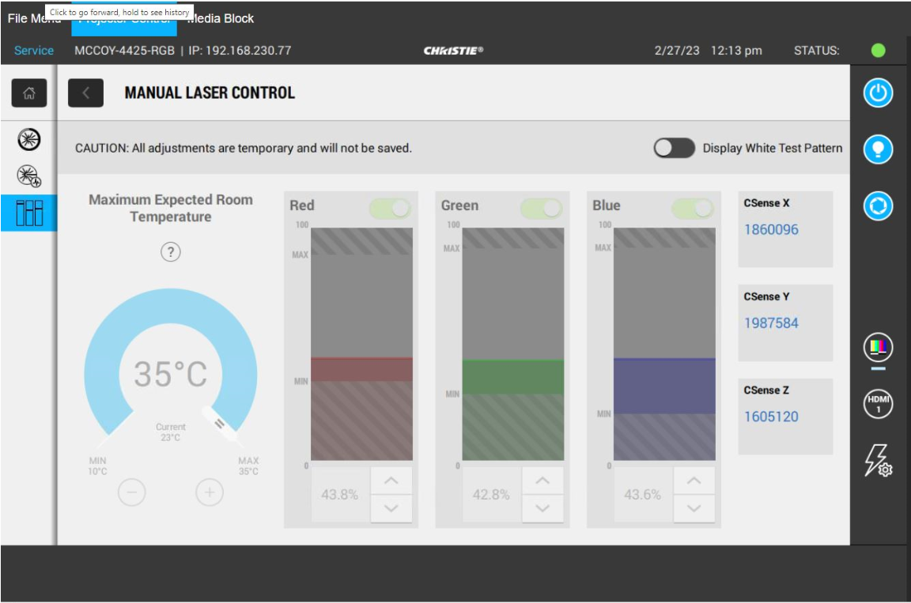
Disabling LiteLOC v3
Disabling LiteLOC v3:
If you enter the Manual Laser Control Screen (Laser Settings -> Manual Laser Control) you will temporarily disable LiteLOC. Here you can click “Display White Test Pattern and change the Red, Green and/or Blue drive levels.
The only time you would need to enter this screen is after replacing a LOS and needing to perform coupling mirror adjustments. Like mentioned earlier in the training material you must take serious caution when replacing the coupling mirror.
Notes:
HTSM = Humidity Temperature Sensor

Slide 25
Disabling LiteLOC v3
Disabling LiteLOC v3:
Let’s imagine that instead of using LiteLOC v3, we simply adjust the red, green and blue laser drive levels on this screen, then save that and apply it to our screen file. Technically, it would work for achieving brightness and our desired white point that day.
The problem is after more and more laser usage our white point would change/drift! This since as our lasers age they will not achieve the same color measurements at the same drive levels. Different drive levels are required to achieve the same CX, CY and CZ values.
When using LiteLOC v3, it ensures that the CX, CY and CZ always stay consistent by adjusting the laser drive levels to accommodate. This is why LiteLOC v3 is so important! We always have a reliable chromaticity measurement when using LiteLOC.
Notes:
HTSM = Humidity Temperature Sensor

Slide 26
LiteLOC v3 Importance
Why is it so important to run LiteLOC v3:
It ensures we can maintain accurate color chromaticity values on screen along with brightness.
It is expected that all customers use LiteLOC v3 when operating Christie projectors.
Notes:
HTSM = Humidity Temperature Sensor

Slide 27
Troubleshooting - LiteLOC Not achievable
Troubleshooting LiteLOC Not Achievable:
If you experience an issue like “LiteLOC Not Achievable”, it could be an issue related to a high temperature, high humidity (for projectors that use the chiller), a Laser Device that’s not functioning correctly, etc. Below is a sequence of steps you should try to troubleshoot:
Check for any Warnings/Errors in the Remote UI.
Check the temperatures (and humidity if your projector uses a chiller).
Compare the Voltages and Currents associated to your lasers. If any look strange this could be the issue.
Notes:
HTSM = Humidity Temperature Sensor

Slide 28
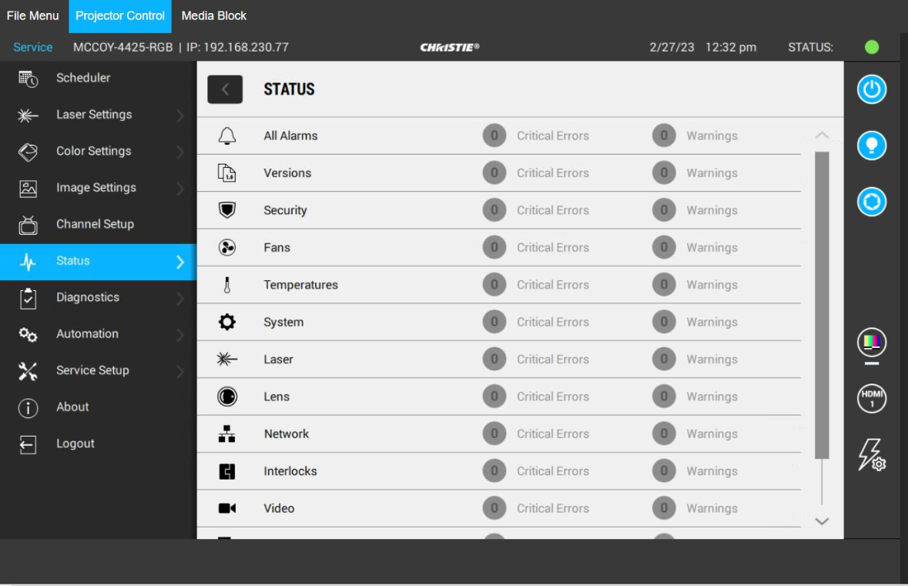
Troubleshooting - LiteLOC Not achievable
Troubleshooting LiteLOC Not Achievable (Status Page):
Notes:
HTSM = Humidity Temperature Sensor

Slide 29
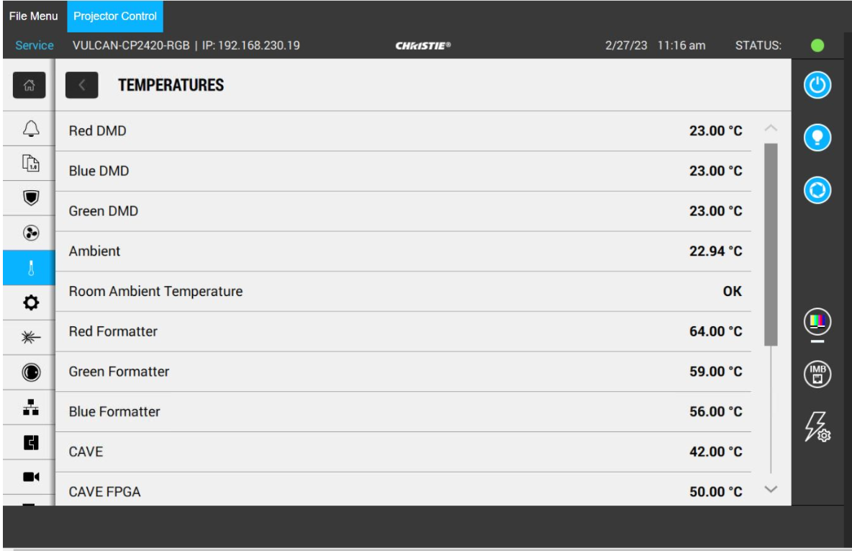
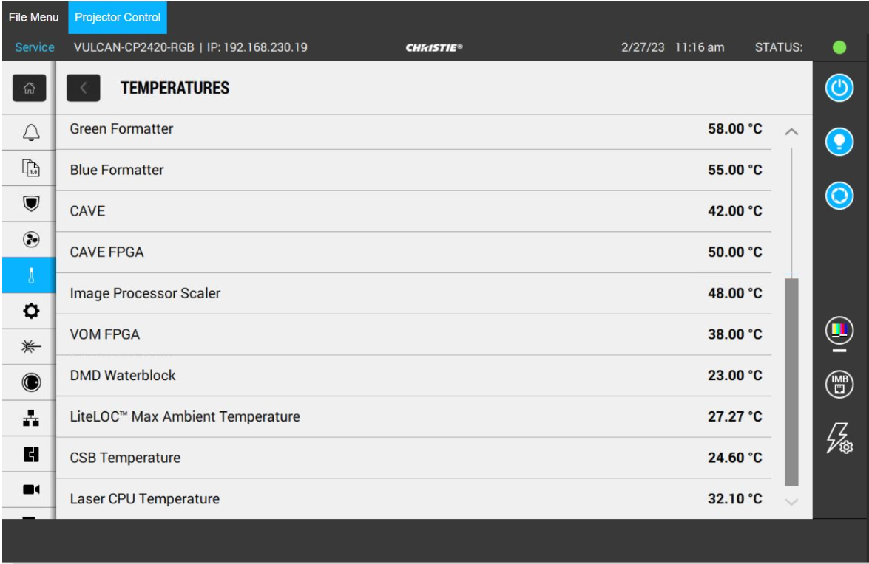
Troubleshooting - LiteLOC Not achievable
Troubleshooting LiteLOC Not Achievable (Temperatures):
Notes:
HTSM = Humidity Temperature Sensor

Slide 30
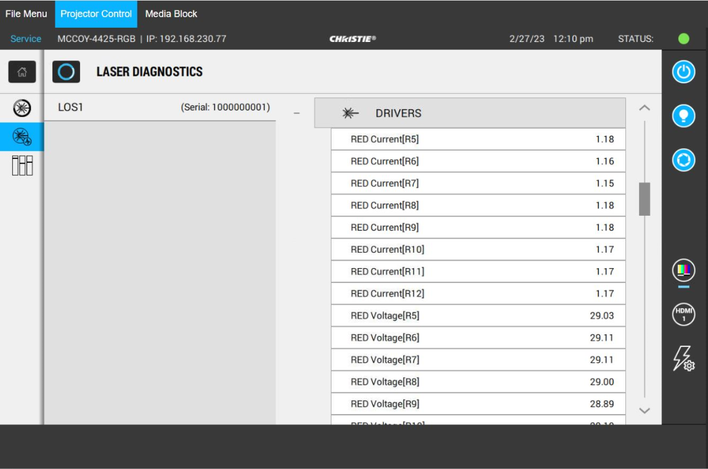
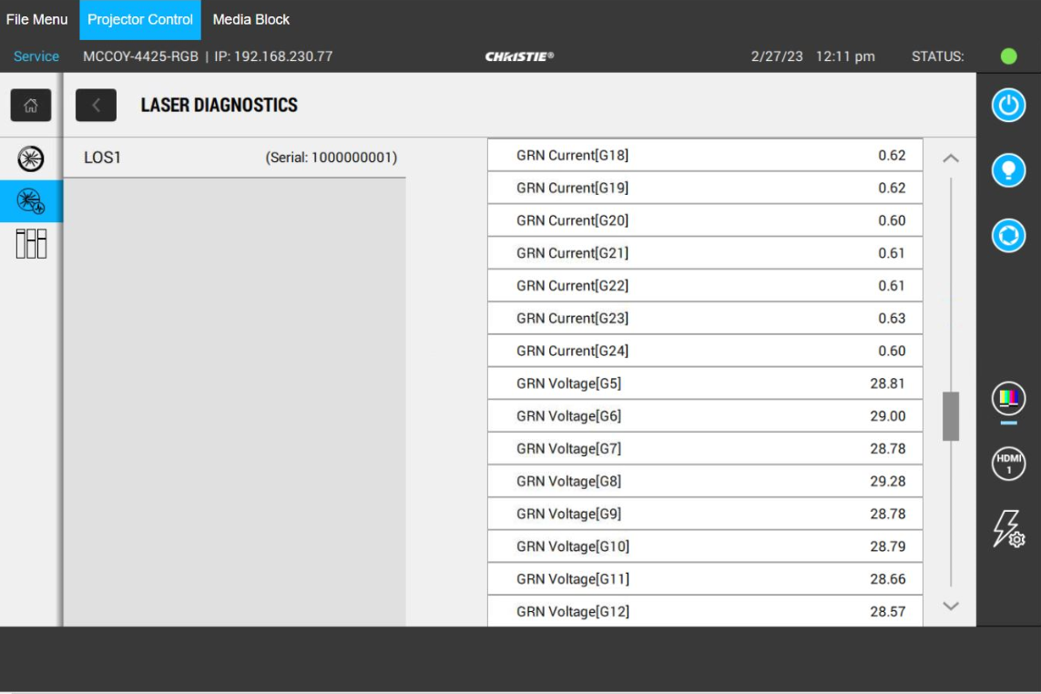
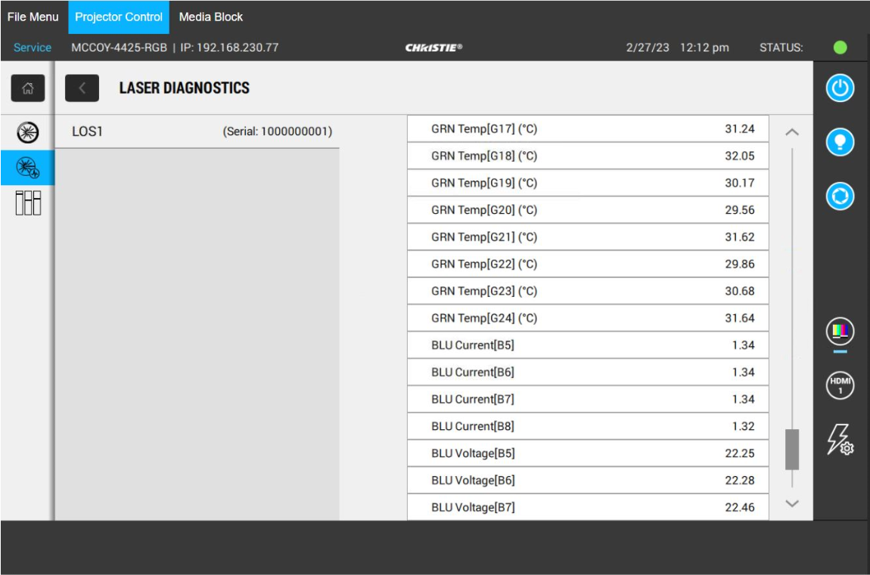
Troubleshooting - LiteLOC Not achievable
Troubleshooting LiteLOC Not Achievable (Laser): Check for relative consistency. Red, Green and Blue lasers are driven at different voltages and currents. The voltage and current per each color should be relatively consist though.

Slide 31

Post-Training Survey
Post-Training Survey
Please scan the QR code via your mobile device,
or enter the URL to access the survey.
https://www.surveymonkey.com/s/ChristieU
© 2018 Christie Digital Systems Inc. All rights reserved.
All brand names and product names are trademarks, registered trademarks or trade names of their respective holders.
Series III – Field Service September18 v2.0
Notes:
Survey’s should be completed on the final day of training.

